Slide 1


ECEN 403
Team #44
Cubesat EM Material Discharge Eval:
Joshua Feldman
Michael Kim
Ian Poynter
Alejandro Torres
Sponsor: Orbital Arc & SATOP
TA: Peng-Hao Huang

Slide 2
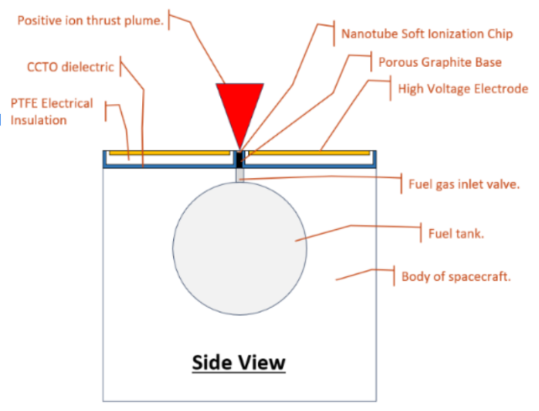
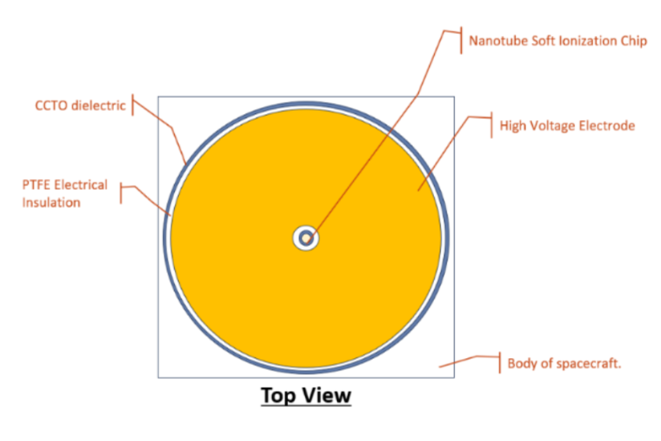
RIOT Drive
Construction of the first prototype for the RIOT Drive by Orbital Arc
Accelerator Plate Data
Microcontroller System
Power Supply Circuitry
Chassis Design

Slide 3
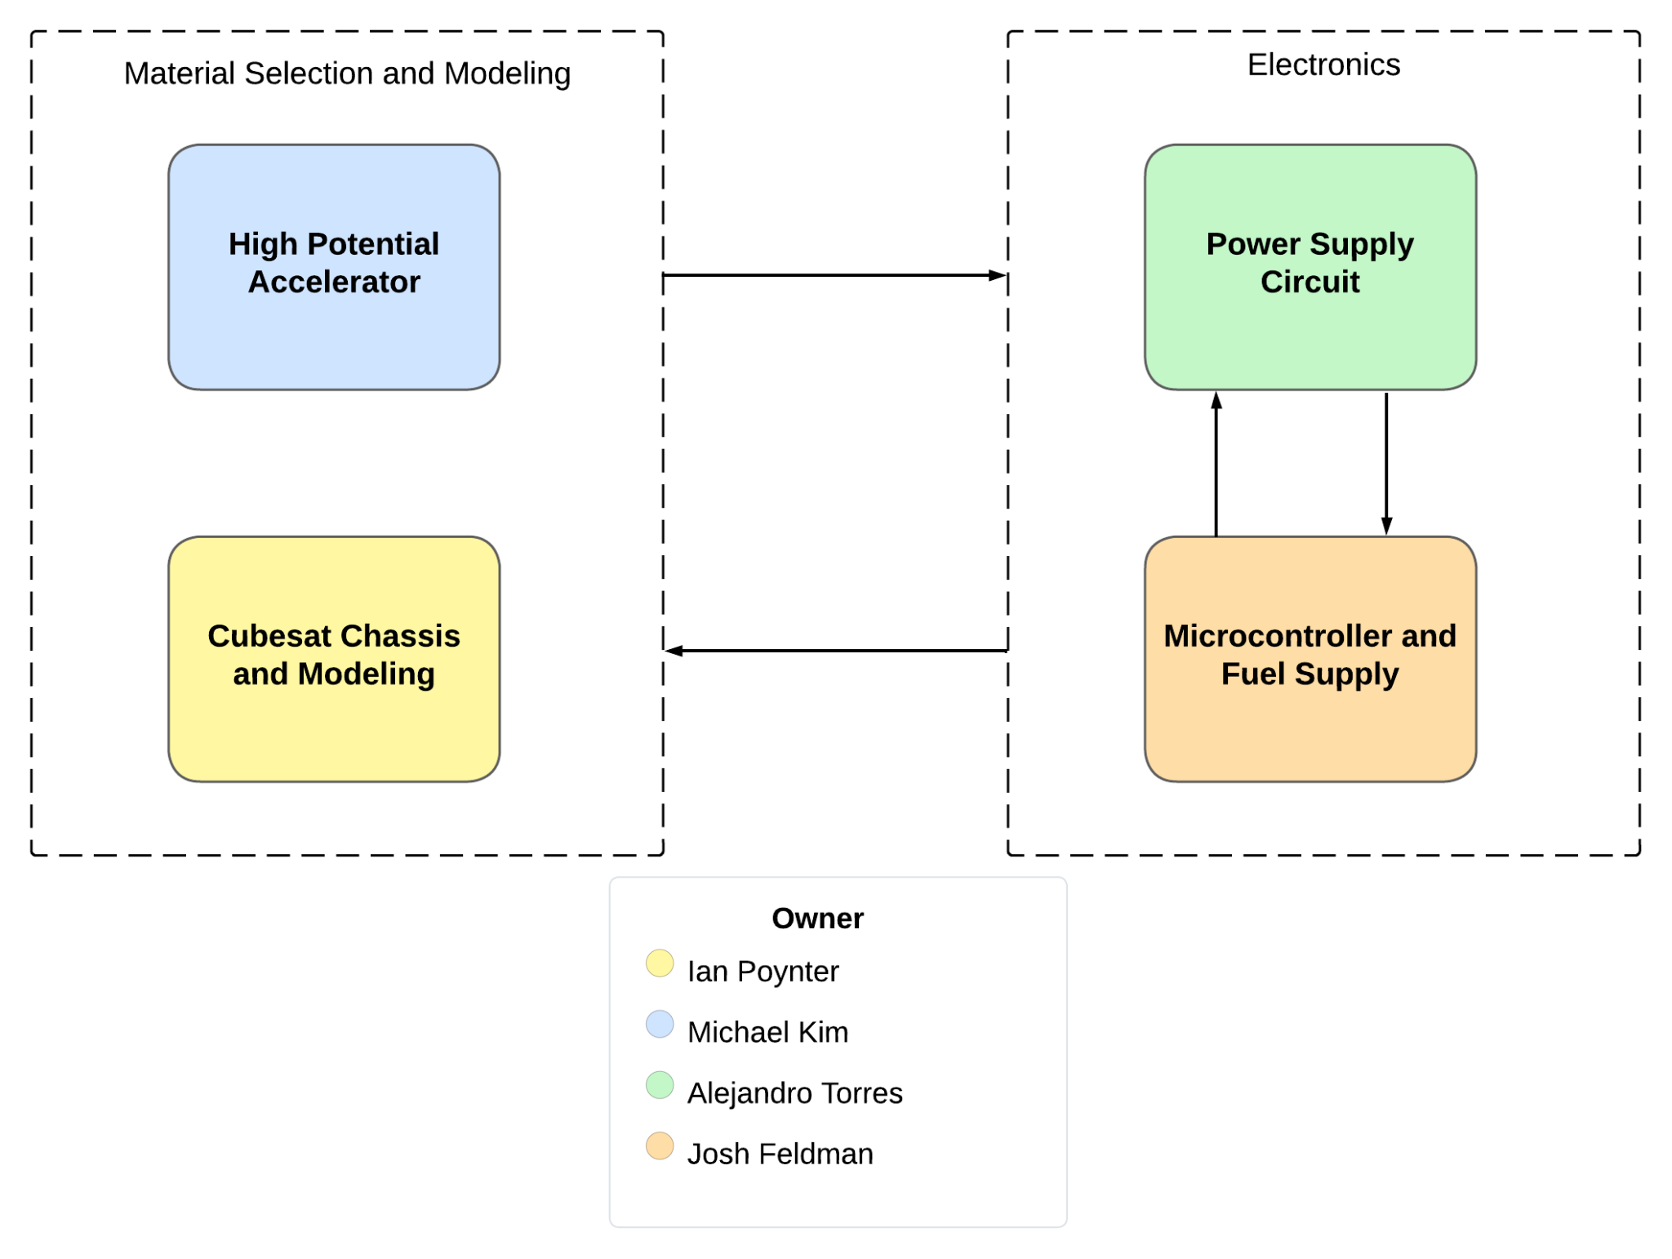
Diagram of Subsystems and Interface

Slide 4
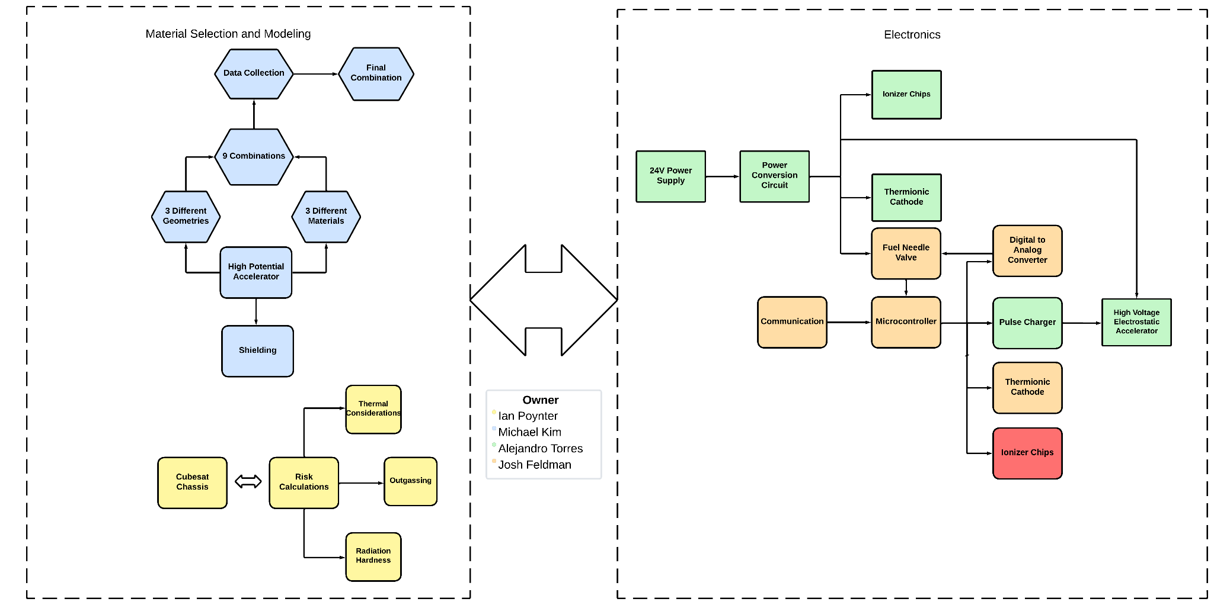
System Block Diagram

Slide 5
CubeSat Chassis Ian Poynter
Accomplishments since the last presentation | Ongoing progress/problems and plans until the next presentation
-Capstone team made decision to build instead of buy -Aluminum stock for parts ordered -Engineering drawings for part outlines | -Create chassis/parts using CAD software -Begin fabrication of corner pieces for chassis

Slide 6
High Potential Accelerator Plate Michael Kim
Accomplishments since the last presentation <~48> hrs | Ongoing progress/problems and plans until the next presentation
Finalized the designs of all 3 geometries using Blender. Ordered parts, including the materials needed for fabrication. Confirmed type of material with our sponsor. | Craft the circular plate. Begin fabricating the Hemisphere Geometry.

Slide 7
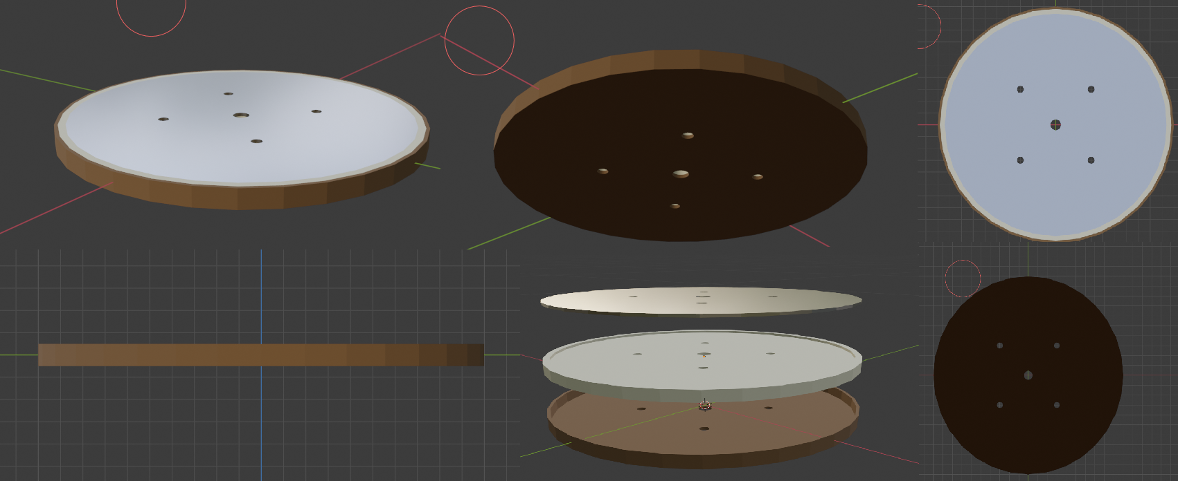
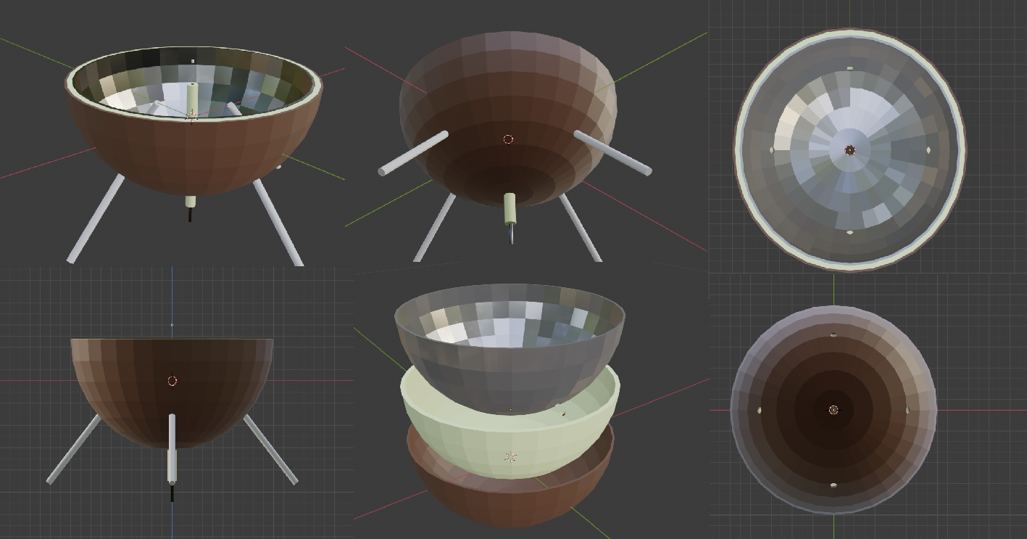
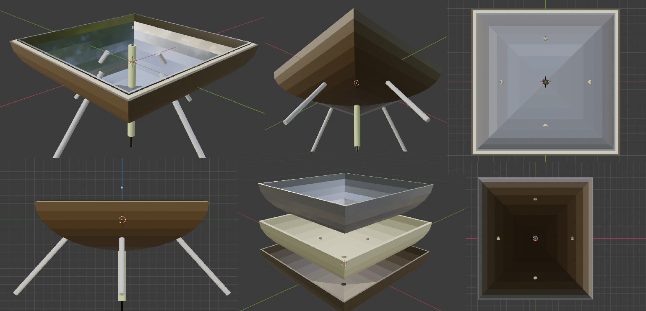

Slide 8
Power Supply Circuit Alejandro Torres
Accomplishments since the last presentation <~90> hrs | Ongoing progress/problems and plans until the next presentation
Simulated Buck Converter on LTSpice Simulated Boost Converter on WEBENCH Ordered Parts needed for PCB Design Finished PCB Design to power external components | Testing Pulse Generator that was given to us by our sponsor Solder, test, and debug PCB

Slide 9
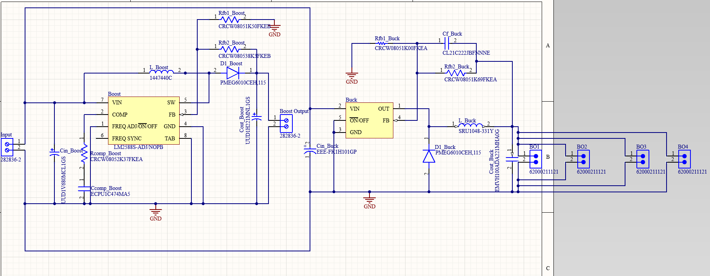
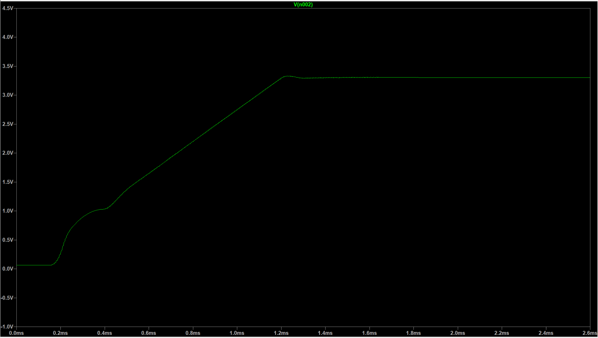
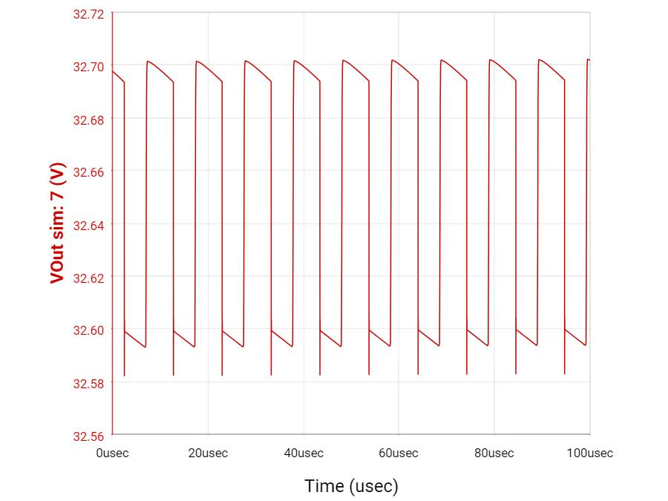
Schematics and Simulations

Slide 10
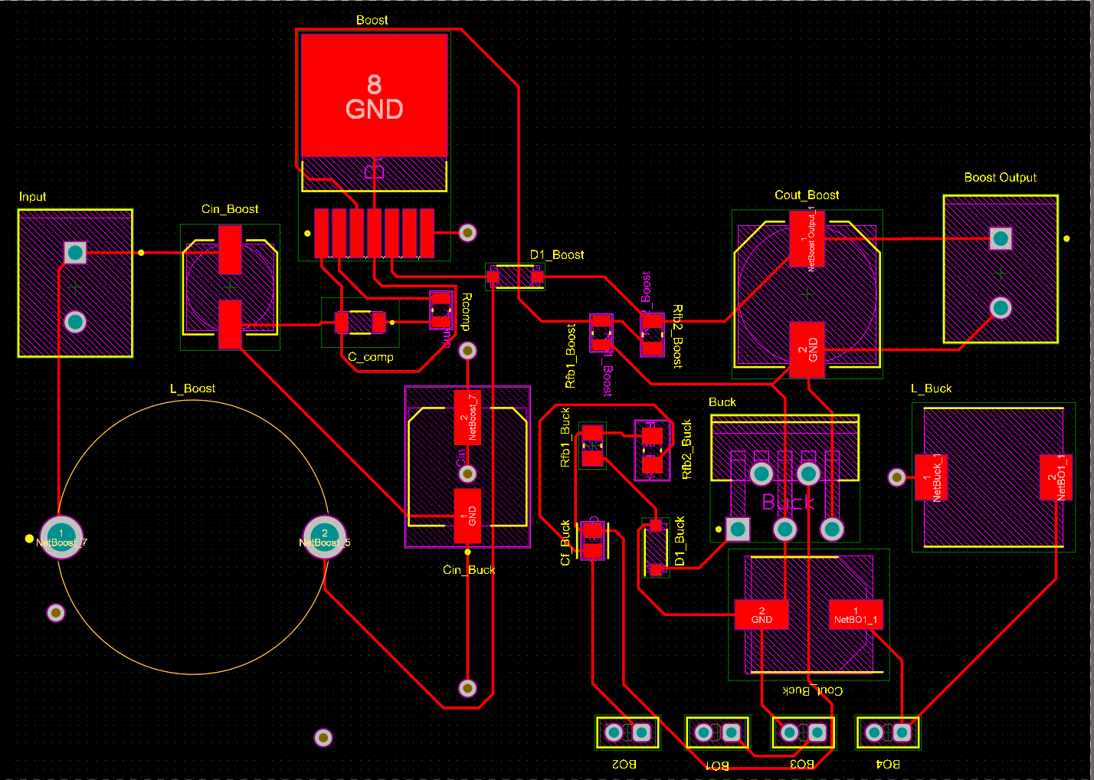
Design

Slide 11
Microcontroller Joshua Feldman
Accomplishments since the last presentation <~45> hrs | Ongoing progress/problems and plans until the next presentation
Additional components for PCB researched. Reviewing specs and datasheets for parts. Schematic for PCB created in Altium. Symbols and Footprints of all parts in Altium. Switches simulated in Mulitsim to ensure they function with the input voltages and currents. | PCB interfaces with Power subsystem, so placement of components may need to be changed for subsystem integration. Microcontroller programming and testing PCB.

Slide 12
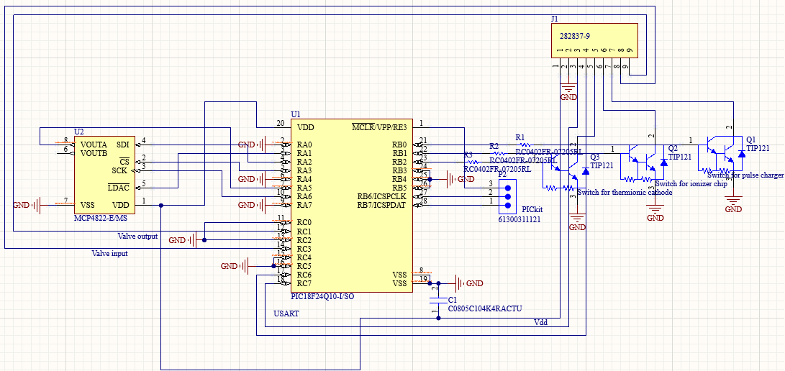

Slide 13
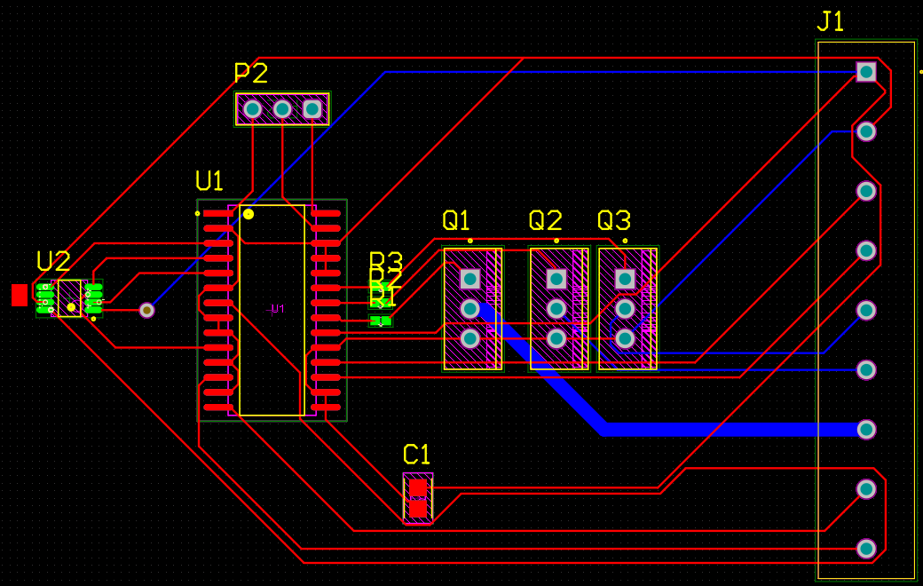

Slide 14
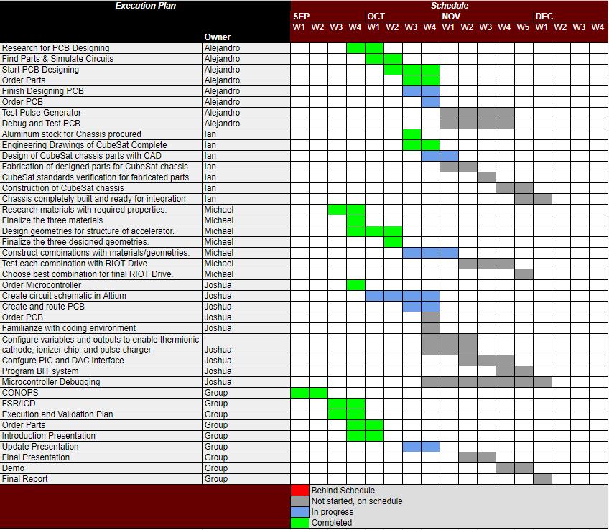
Execution Plan

Slide 15
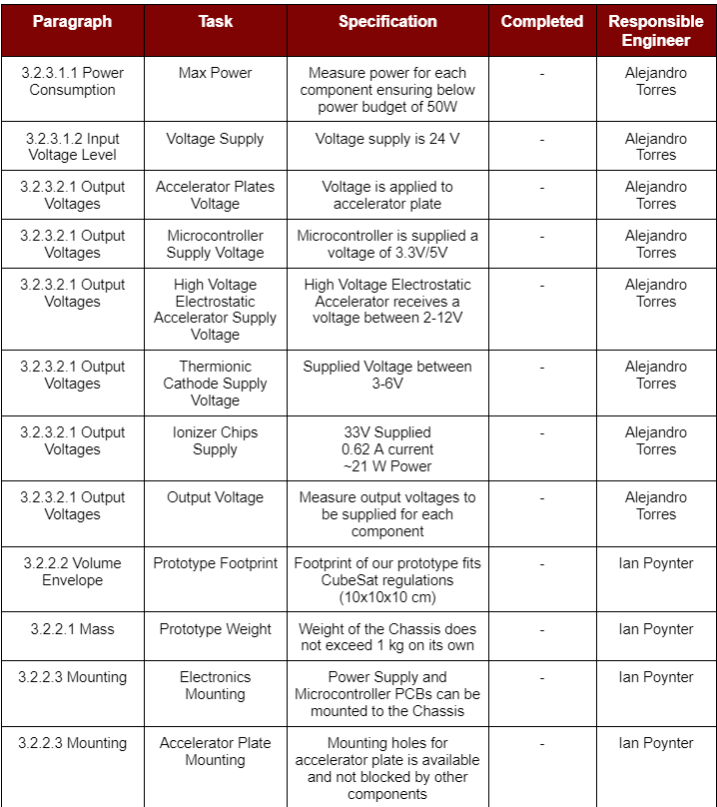
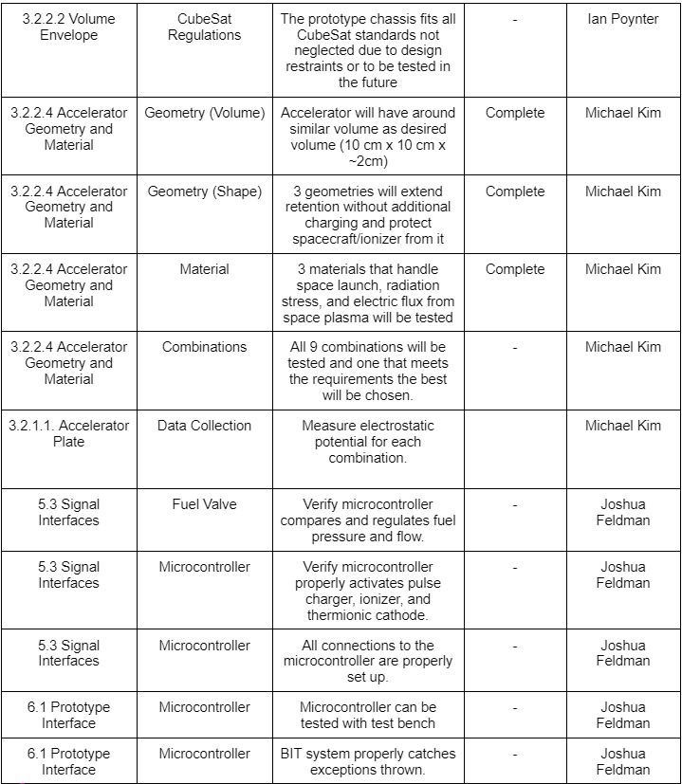
Validation Plan

